Slide 1

Team Id : 26_CS_3G_10
NEURO
ONE
NEURO
ONE
Project Supervisor: Dr. Taresh Singh
Pranveer Singh Institute of Technology

Slide 2
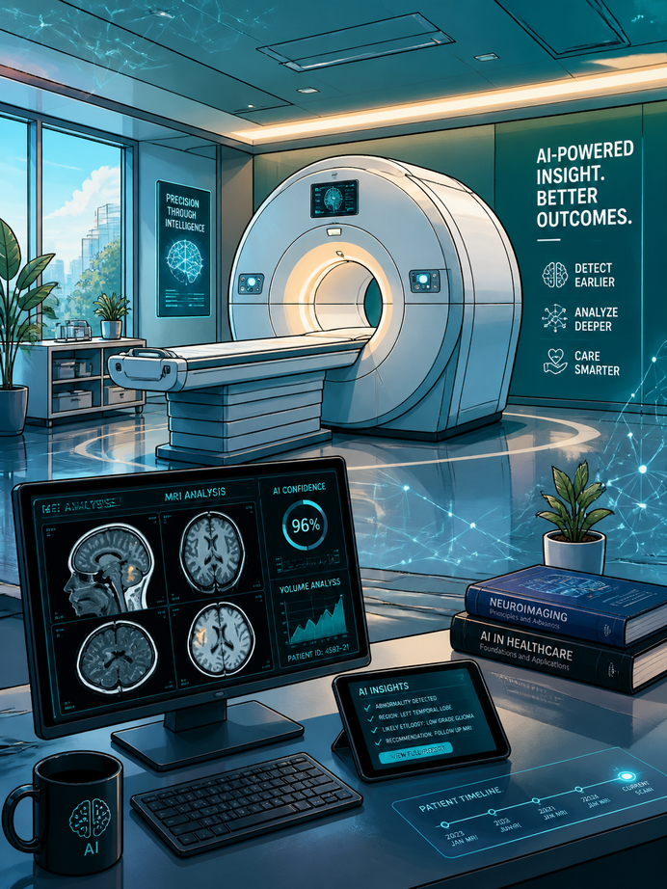
PROBLEM STATEMENT
Neurodegenerative diseases such as Alzheimer's and Parkinson's affect millions of people worldwide. Unfortunately, these conditions are often diagnosed only after significant and irreversible brain damage has already occurred.
Key Challenges :
  Early symptoms are subtle and difficult to detect.
  MRI interpretation requires experienced neurologists.
  Manual diagnosis is time-consuming.
  Many hospitals lack specialist expertise.
  Delayed diagnosis limits treatment effectiveness.

Slide 3

WHY DOES IT MATTER?
WHY EARLY DETECTION IS IMPORTANT ?
Delayed diagnosis can result in:
  Faster disease progression
  Reduced quality of life
  Higher healthcare costs
  Increased burden on caregivers
  Limited treatment options
CURRENT LIMITATIONS
  Dependence on specialists
  Long waiting times
  Human variability in interpretation
  Limited accessibility in rural areas

Slide 4
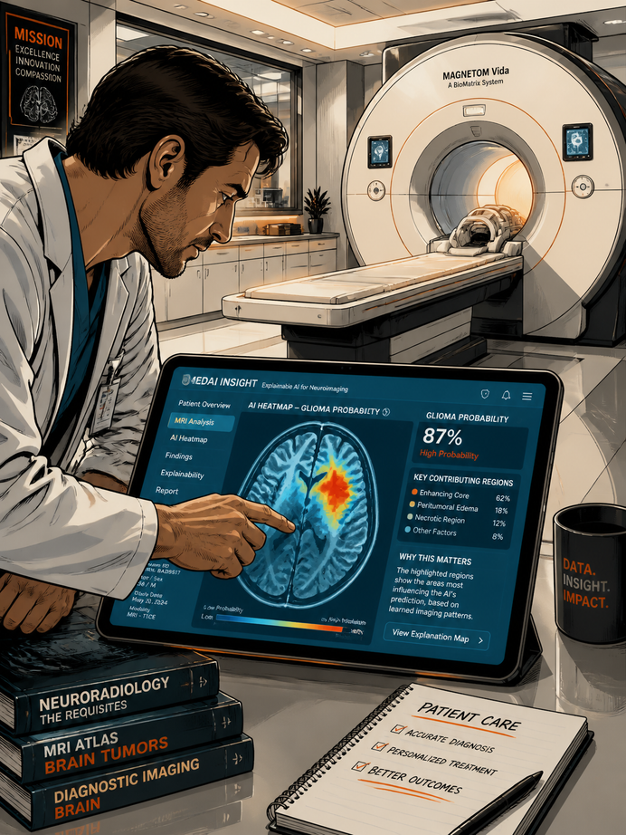
PROPOSED SOLUTION
NeuroOne is an AI-powered clinical decision support system designed to assist doctors in the early detection of neurodegenerative diseases using MRI scans.
WHAT IT DOES?
  Accepts brain MRI scans
  Uses AI to analyze imaging patterns
  Predicts the likelihood of disease
  Highlights important regions using Explainable AI
  Stores reports securely for future reference

Slide 5
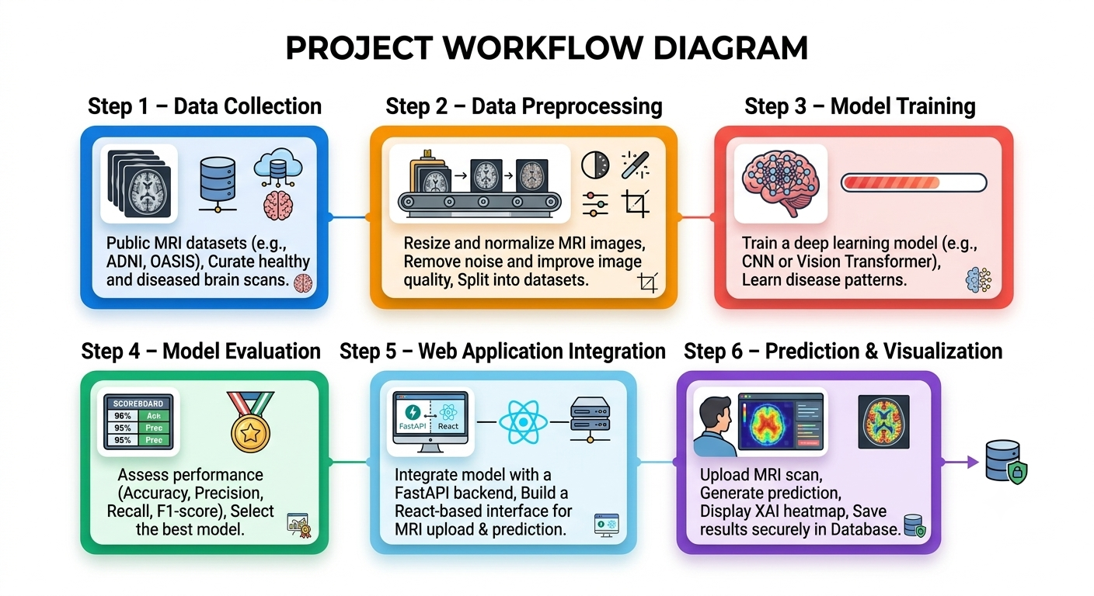
PROPOSED METHODOLOGY

Slide 6
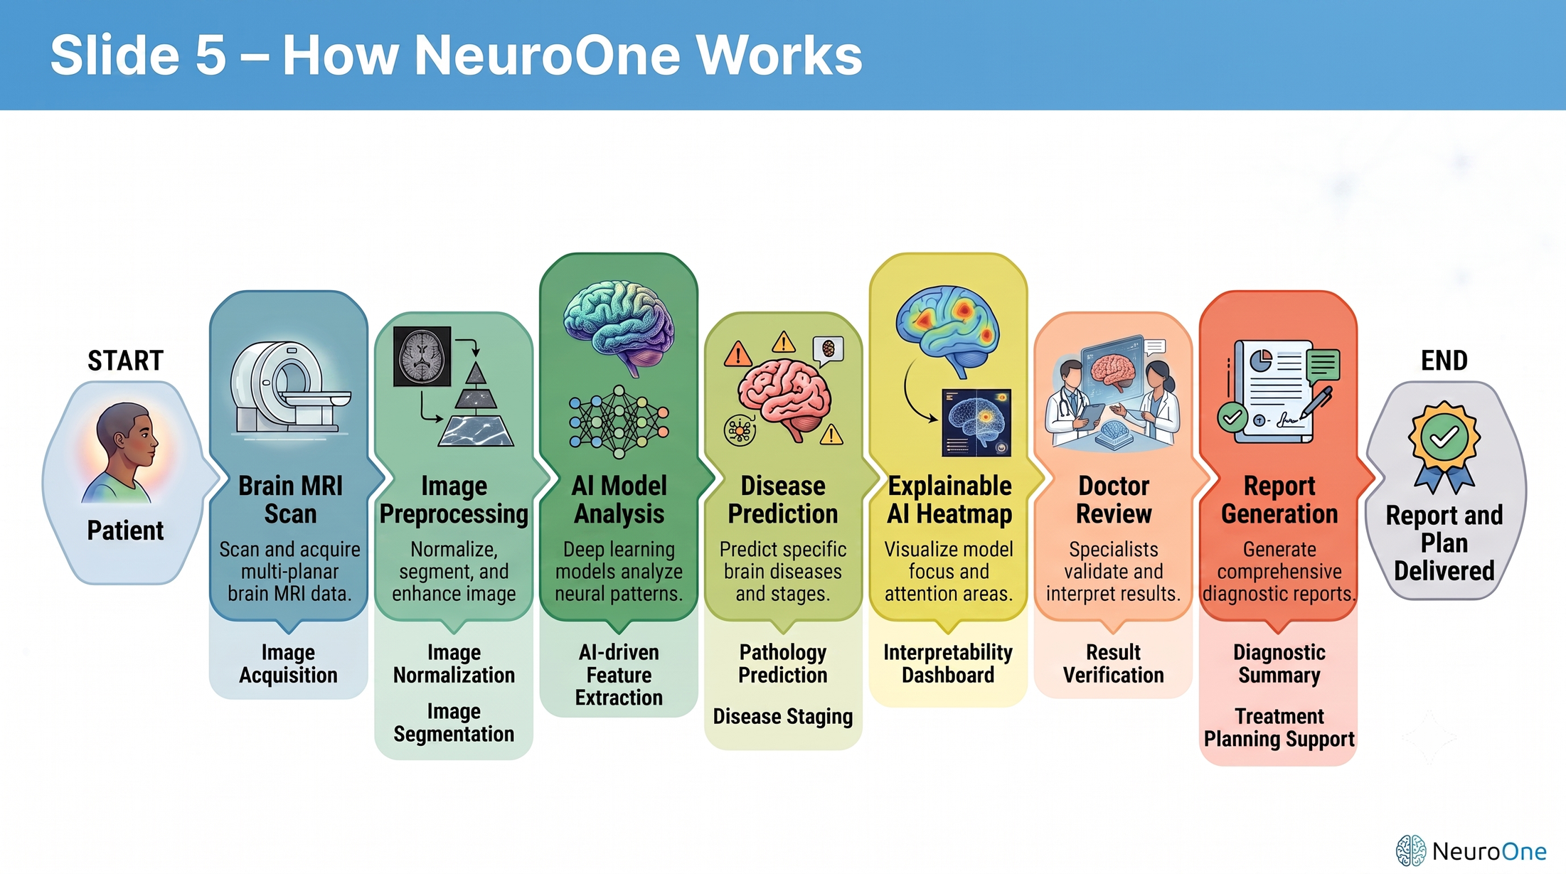
WORKFLOW

Slide 7
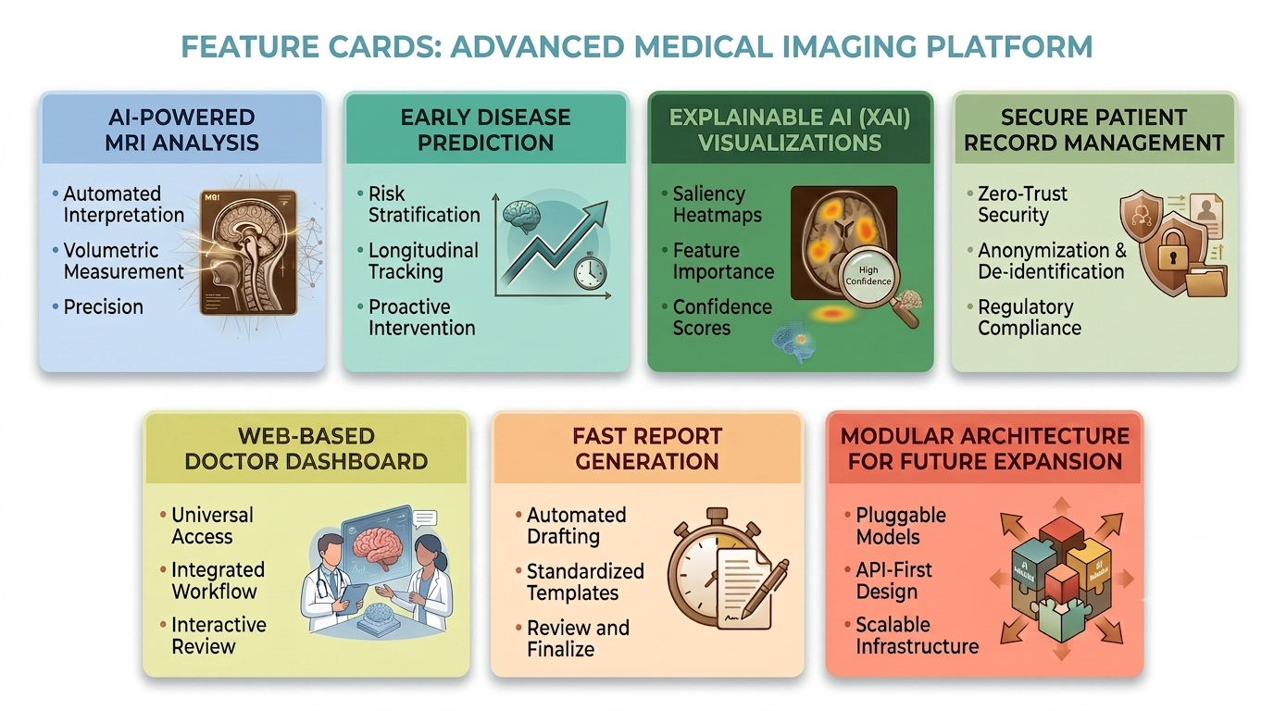
FEATURES

Slide 8
FEASIBILITY ANALYSIS
TECHNICAL FEASIBILITY
OPERATIONAL FEASIBILITY
  Public MRI datasets (ADNI, OASIS)
  Python & PyTorch for AI model development
  React + FastAPI for web application
  PostgreSQL for secure data storage
  Easy-to-use web interface
  Minimal training required
  Can integrate into existing clinical workflows
ECONOMIC FEASIBILITY
SCALABILITY
  Open-source technologies
  Google Colab for AI training
  Low infrastructure cost
Designed to support additional diseases and imaging modalities in future versions

Slide 9
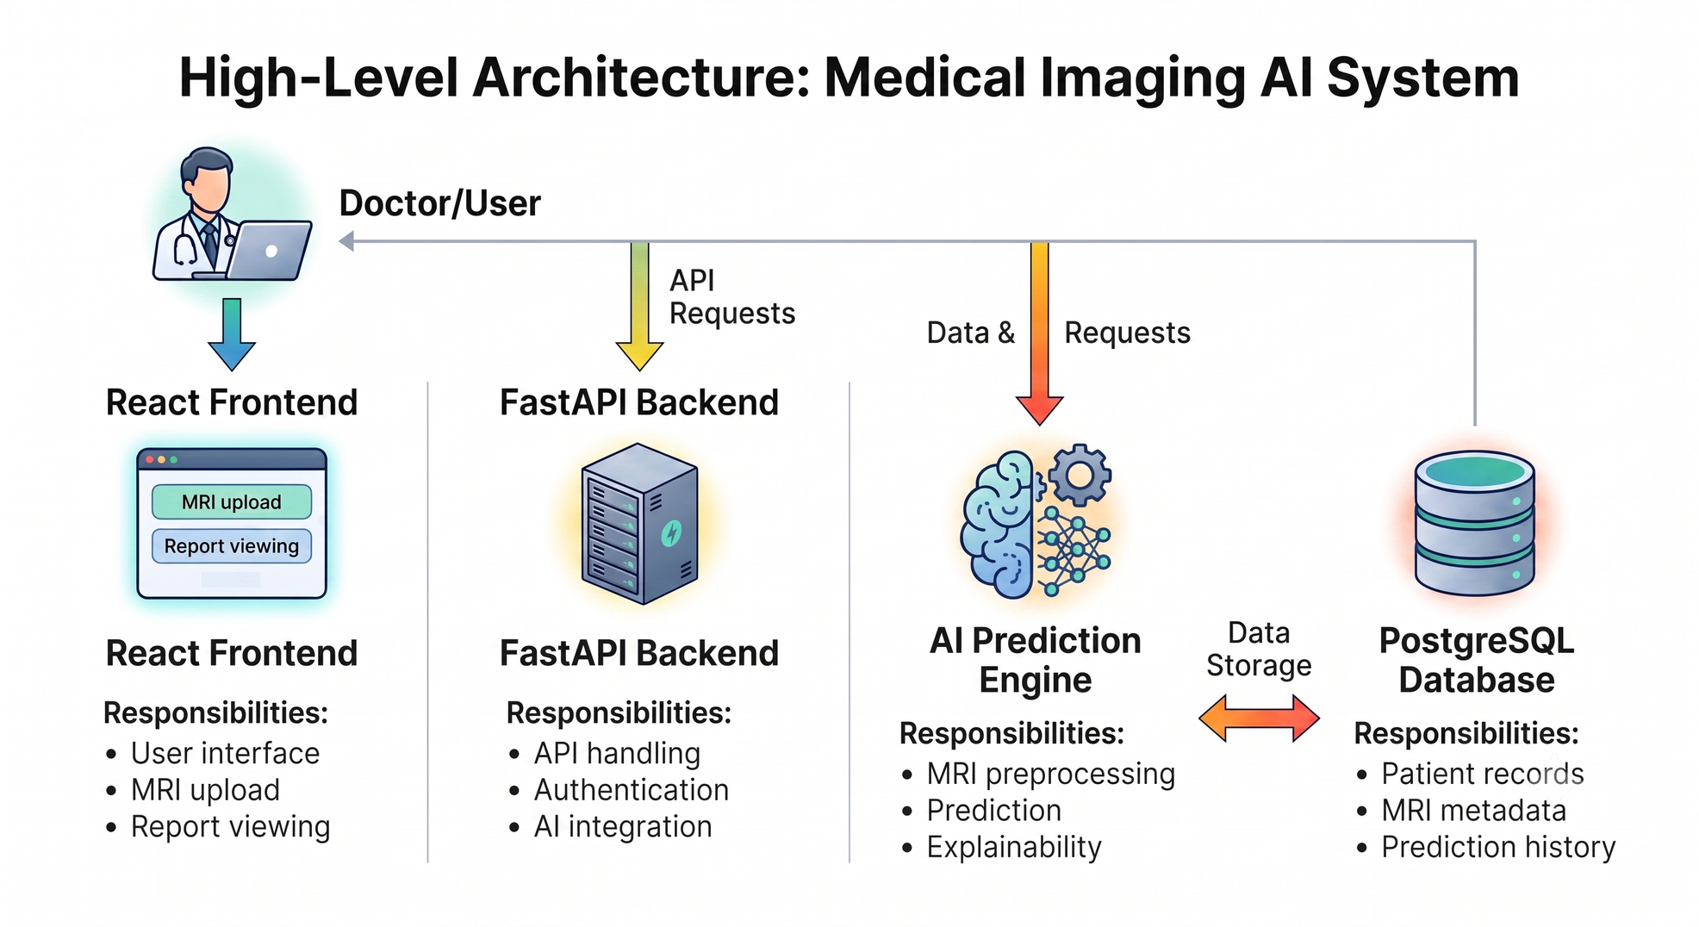
SYSTEM ARCHITECTURE

Slide 10
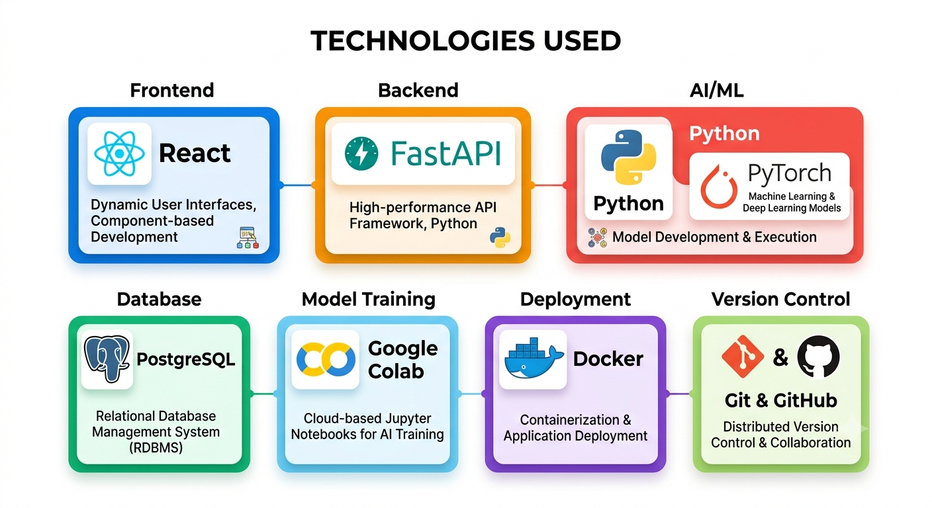
TECH STACK

Slide 11
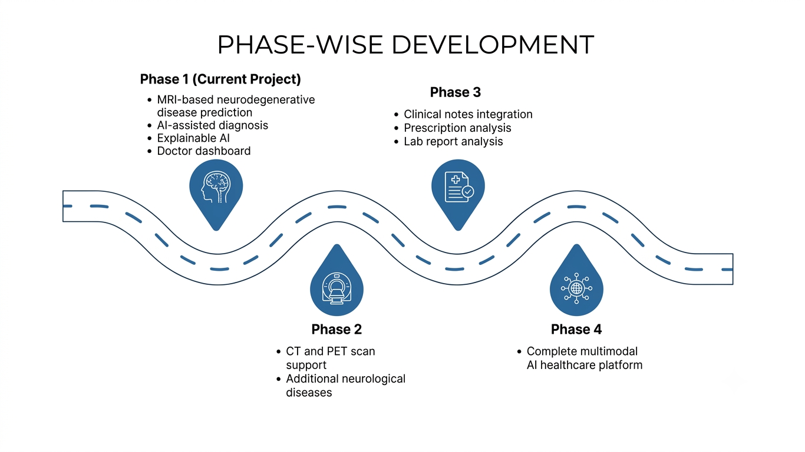
DEVELOPMENT ROADMAP

Slide 12
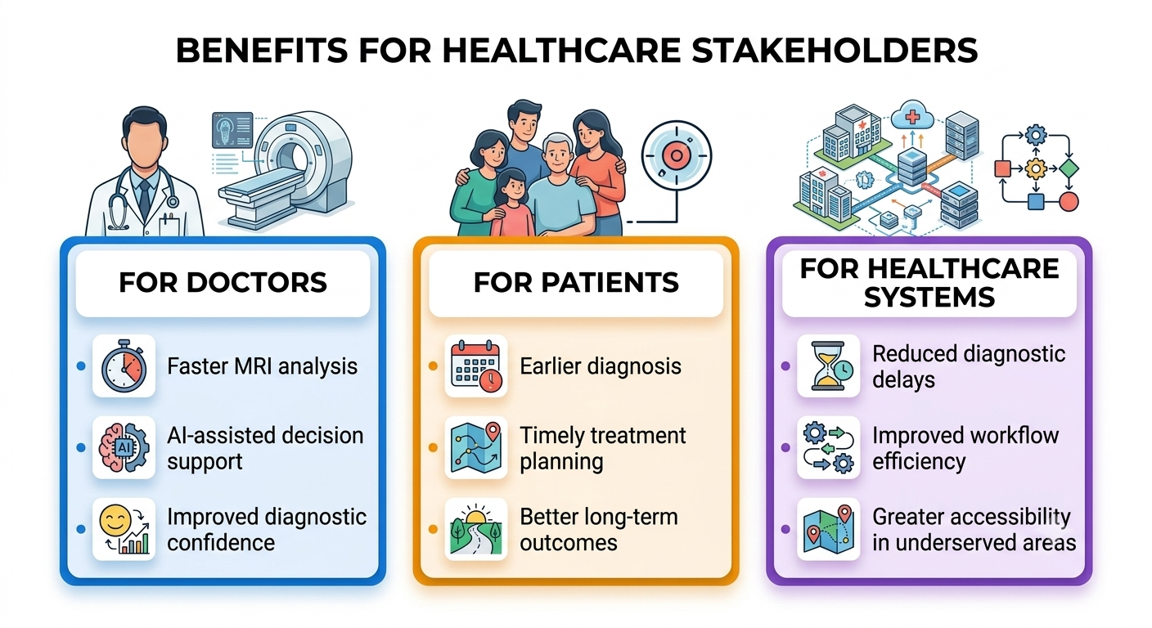
EXPECTED IMPACT

Slide 13
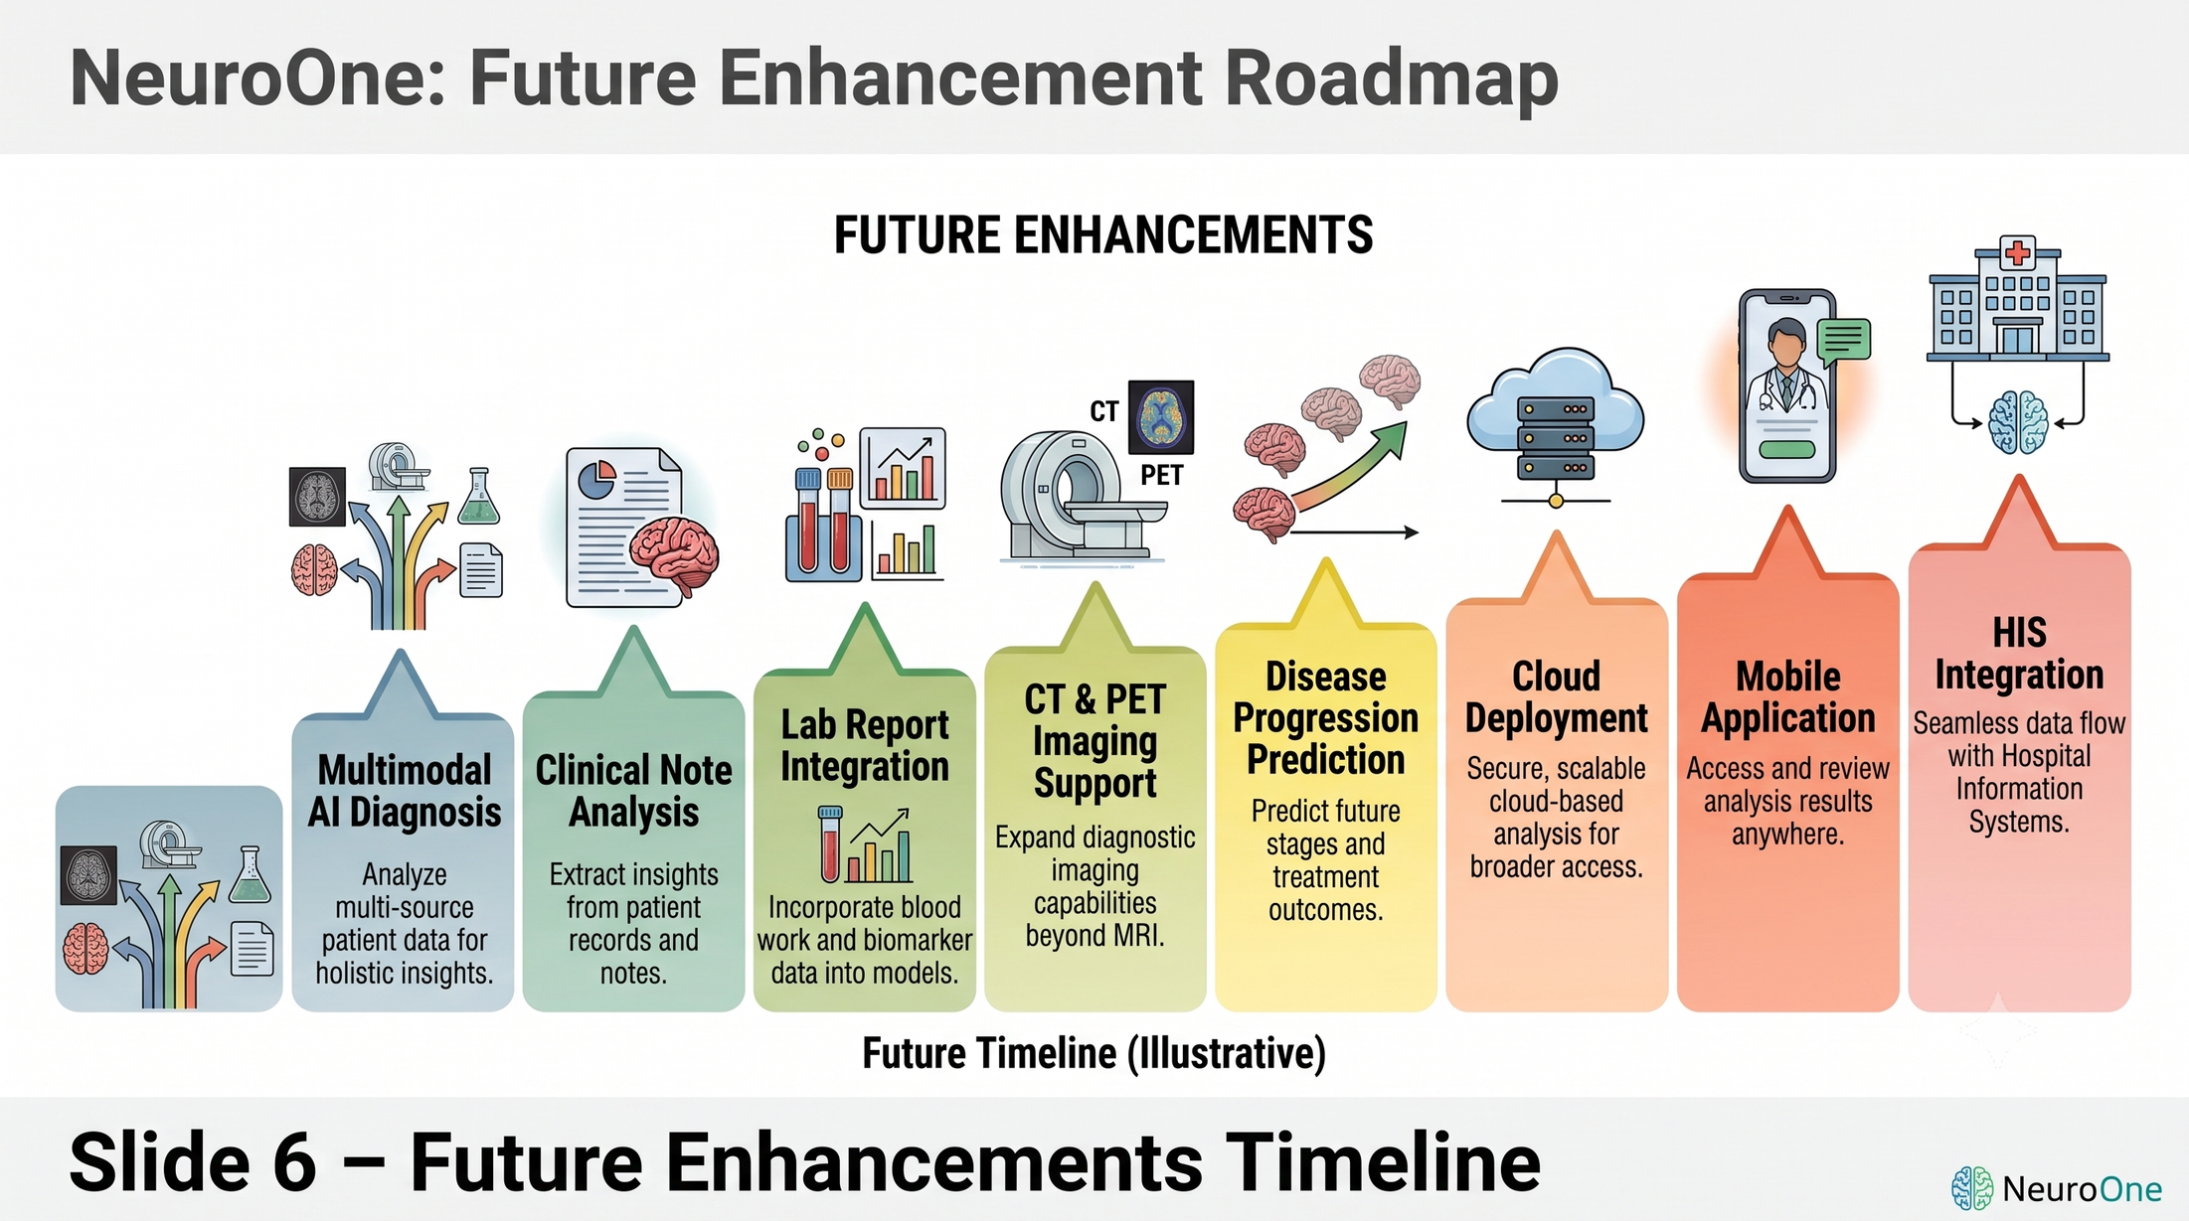
FUTURE SCOPE

Slide 14
CONCLUSION
Why NeuroOne?
NeuroOne aims to bridge the gap between medical expertise and artificial intelligence by providing clinicians with a reliable decision support system for early neurodegenerative disease detection.
Key Highlights :
  Addresses a real healthcare challenge
  AI-assisted and explainable
  Cost-effective using open-source tools
  Scalable and future-ready
  Designed to support—not replace—medical professionals

Slide 15
Team Id : 26_CS_3G_10
THANK YOU
By Team NeuroOne
Pranveer Singh Institute of Technology

